Slide 1
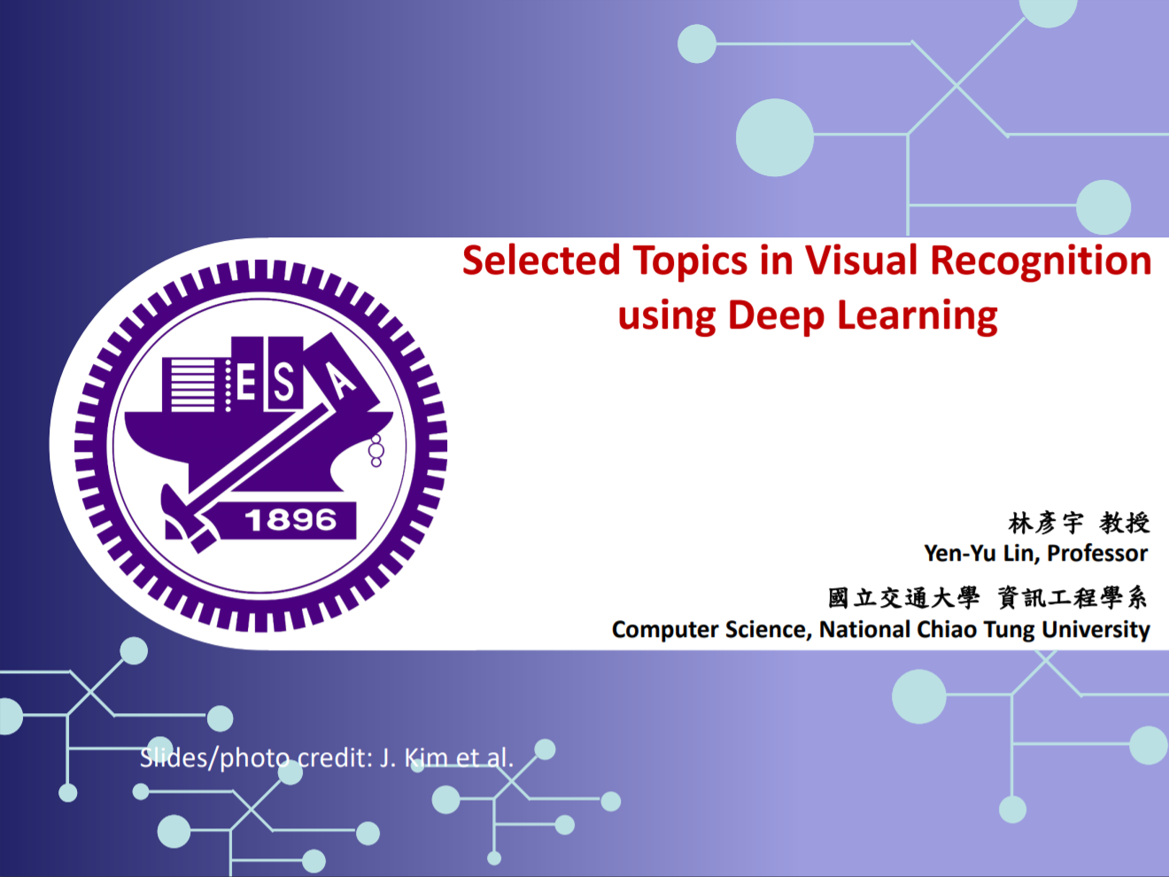
Final Project – iNaturalist competition
唐甫頌 Kim-Benjamin (0845058)
林彦岑 (0856125)
許可 (0840033)

Slide 2
Today’s agenda
Introduction
Related Work
Proposed Approach
Experiment Results
Conclusions

Slide 3
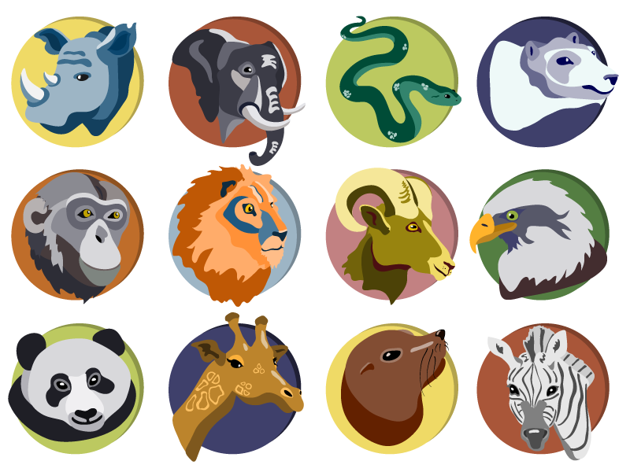
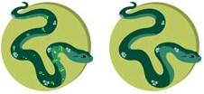
Introduction
Motivation:
Problem
Several million species of plants and animals
Difficult to classify with no expert knowledge due to similarities
Solution
Competition to push technologies for automatic classification with large number of fine-grained categories

Slide 4
Introduction
Goal of competition:
Fine-grained multi-class species classification with images
High accuracy within a limited time period
Evaluation metric: top-1 classification error
If label for image matches – error: 0
If label does not match – error: 1
Final score averaged over all instances
Dataset in total contains 268,243 images
Very similar categories
1010 different species

Slide 5
Related Work
(Have a look at https://www.kaggle.com/c/inaturalist-2019-fgvc6/notebooks and https://www.kaggle.com/c/inaturalist-2019-fgvc6/discussion, summarize models they use and results they get. Include the unique points (such as the difference about pre-processing data and etc.) as details and describe pros and cons.)

Slide 6
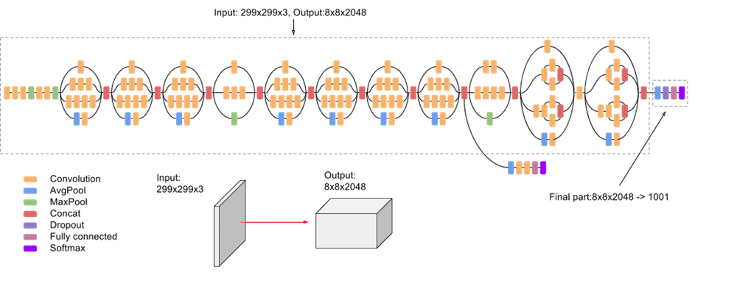
Proposed Approach
GitHub Link
Model: Inception V3 model (from TensorFlow)

Slide 7
Proposed Approach
Data processing:
Load the data (images with annotations)
Augment the data:
Uniform size of 299x299 resolution
For color: brightness, contrast, saturation, hue modifications
For image: Scaling, flipping, center crop
Training:
Tune hyperparameters, epochs and batch sizes

Slide 8
Experiment Results
(transferred dataset, metrics we use.) (our score vs highest score) (Ablation studies)

Slide 9
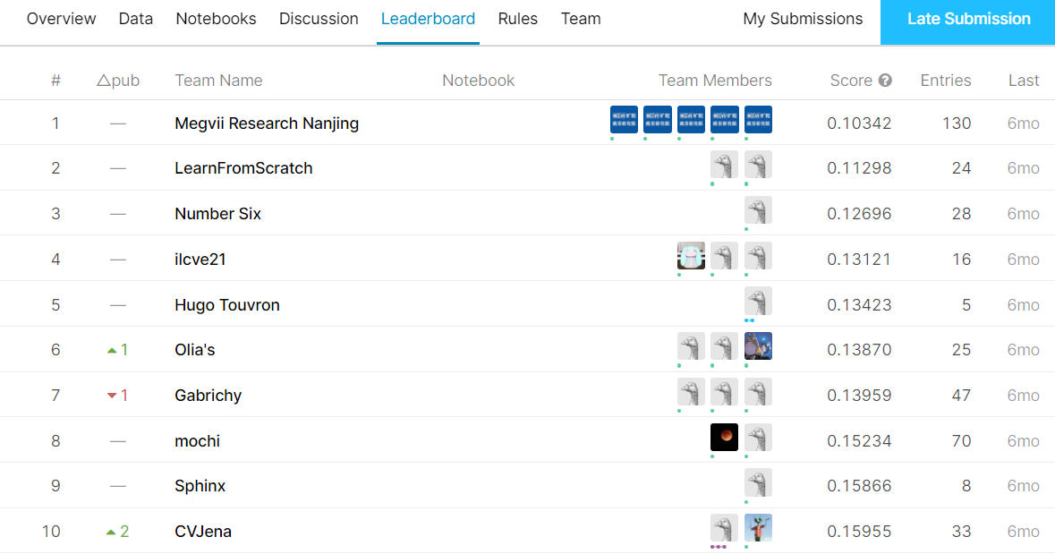
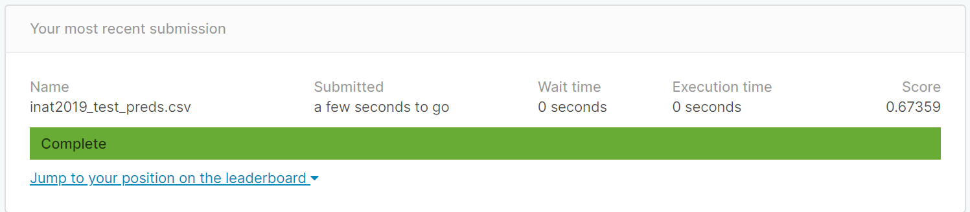
Experiment Results
Low performance compared to the best of the competition
Would score at #159 out of 214 on competition leaderboard (Top 74 %)

Slide 10
Conclusions
Challenges:
Storage issues:
Over 85gb in .zip format was too much for Kaggle / Google Colab
Memory issues:
Own computer had insufficient memory, e.g. 4GB ram
As a solution the computation was executed in the lab

Slide 11
Conclusions
Data augmentation helped to improve the performance
Very difficult task
Difficult to achieve a high performance

Slide 12
Thank You for Your Attention!

Slide 13
References
Images:
Animals: https://briefbox.me/wp-content/uploads/2017/04/animal-icons.png
Inception v3: https://cloud.google.com/tpu/docs/inception-v3-advanced
Related work: https://www.kaggle.com/c/inaturalist-2019-fgvc6/discussion
Code: https://www.kaggle.com/c/inaturalist-2019-fgvc6/notebooks

